Slide 1
Lab Equipment Vocabulary

Slide 2
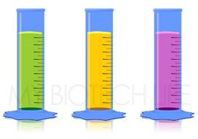
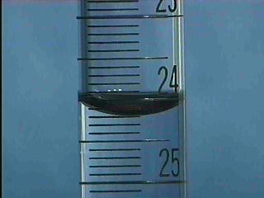
Graduated Cylinder
A narrow container shaped like a cylinder and marked with lines for measurement.

Slide 3
Hand Lens/Magnifiying Glass
A magnifying glass you hold in your hand and use.

Slide 4
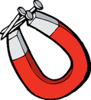
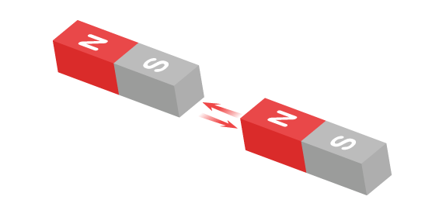
Magnet
A piece of iron or steel that attracts certain substances.

Slide 5
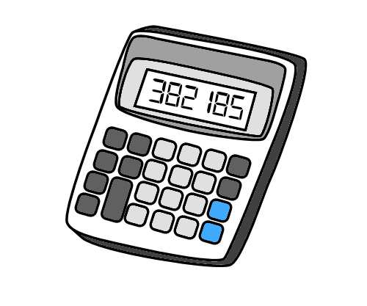
Calculator
A small device that performs math calculations.

Slide 6
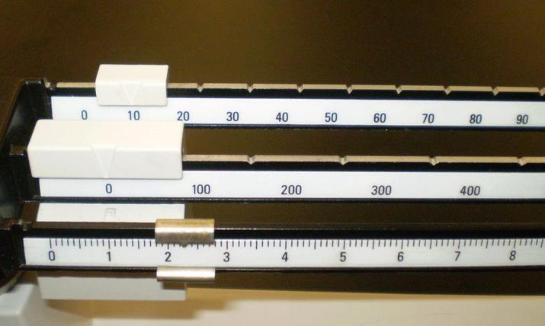
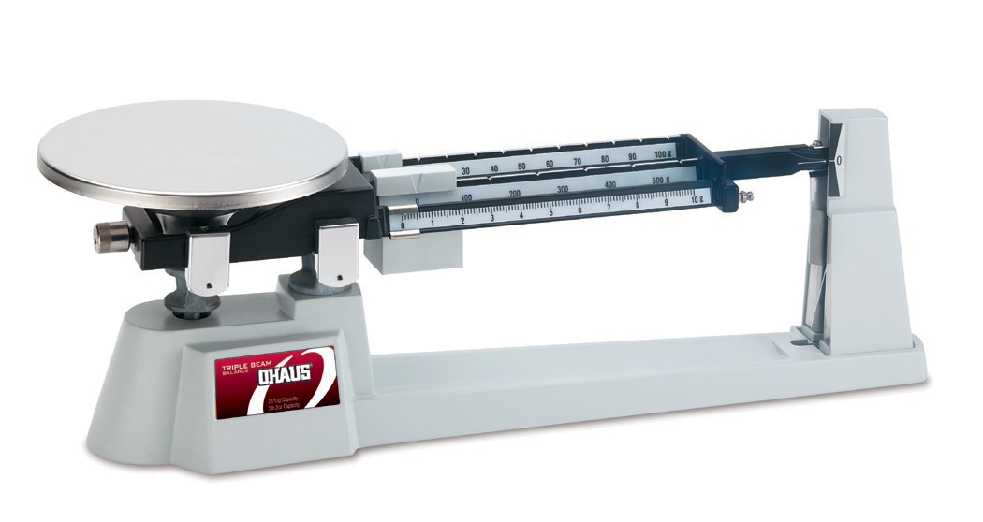
Triple Beam Balance
A balance used to determine mass.

Slide 7
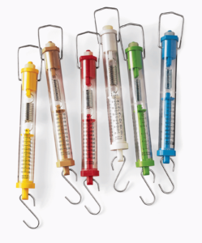
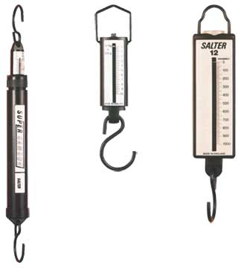
Spring Scale
A balance that measures the weight by the tension of a spring.

Slide 8
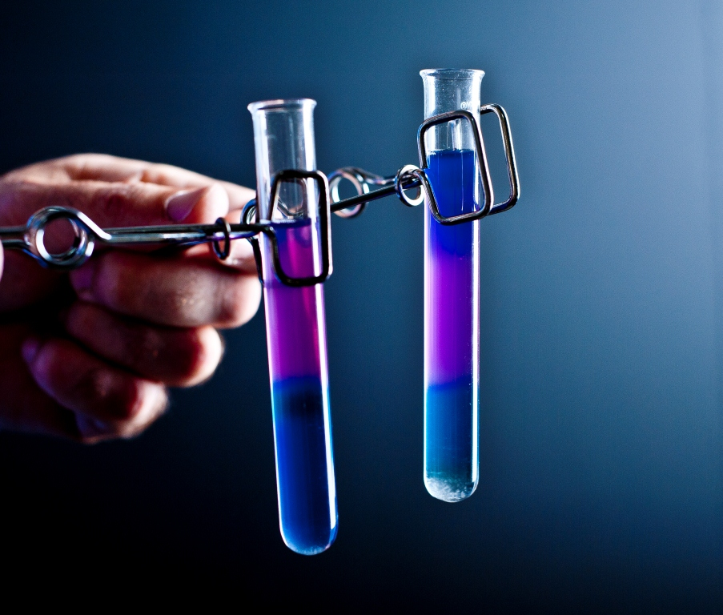
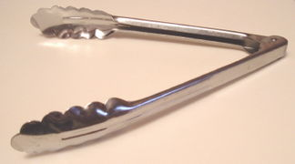
Tongs
An instrument with two hinged arms used for lifting.

Slide 9
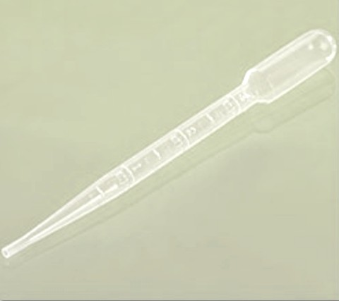
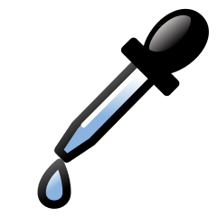
Pipette
A slender tube used for transferring small amounts of liquid.

Slide 10
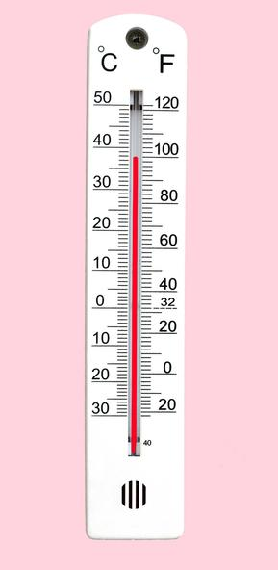
Thermometer
An instrument used for measuring temperature.

Slide 11
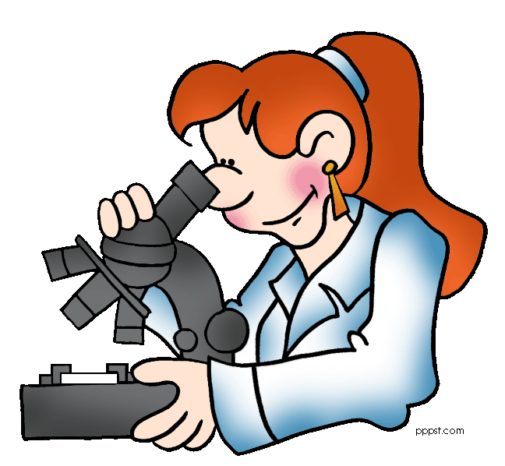
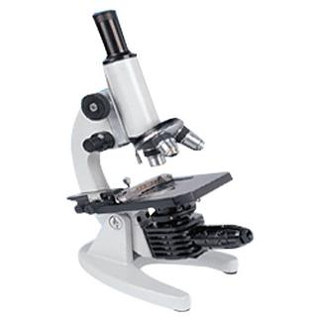
Microscope
An instrument that produces a magnified image of a small object.

Slide 12
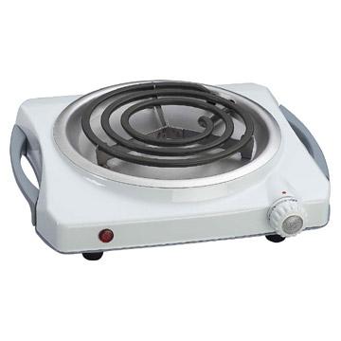
Hot Plate
A portable cooking appliance.

Slide 13
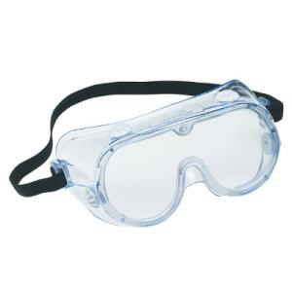
Safety Goggles
Protective eyewear.

Slide 14
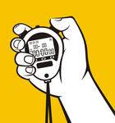
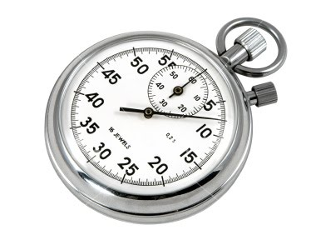
Stop Watch
A type of watch used for precise timing of events.

Slide 15
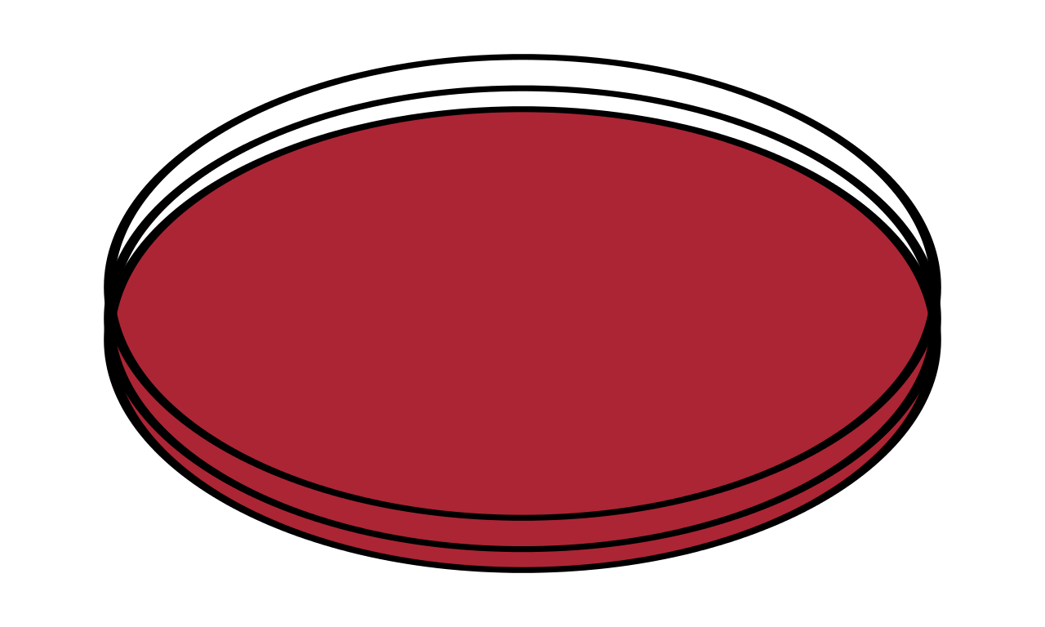
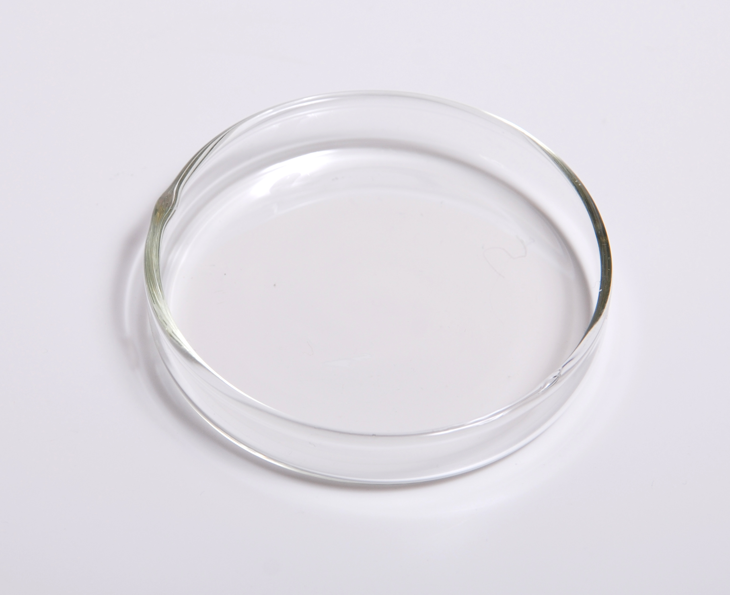
Petri Dish
A shallow dish shaped like a circle with a loose fitting cover.

Slide 16
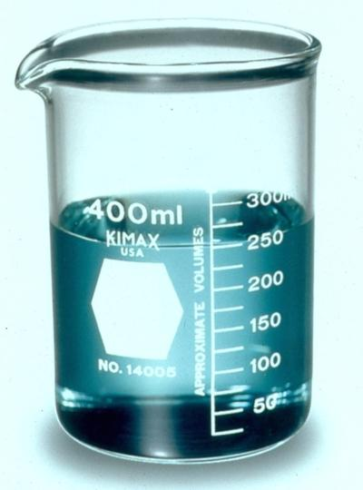
Beaker
A glass container with a flat bottom shaped like a cylinder.

Slide 17
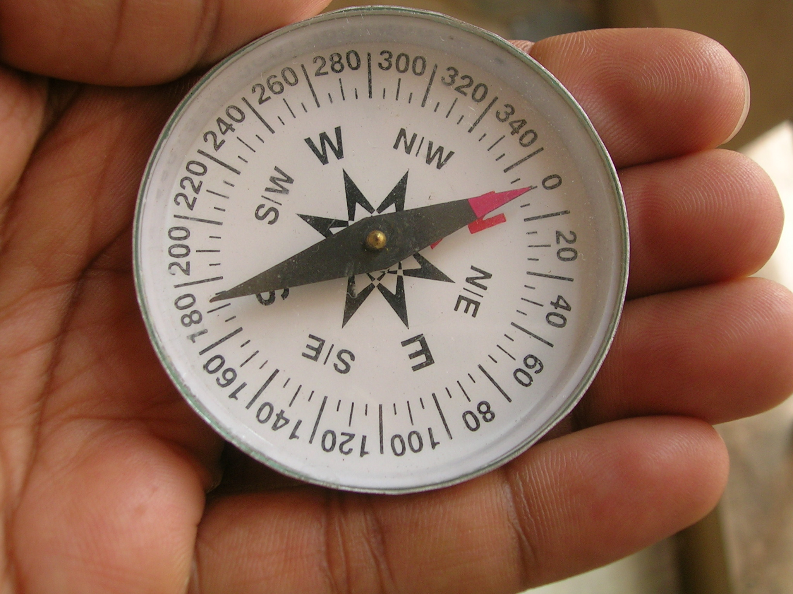
Compass
An instrument that determines direction.

Slide 18
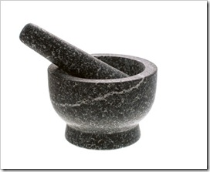
Mortar and Pestal
A device that is used for grinding.

Slide 19
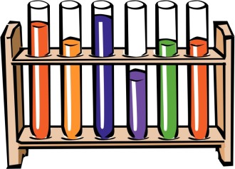
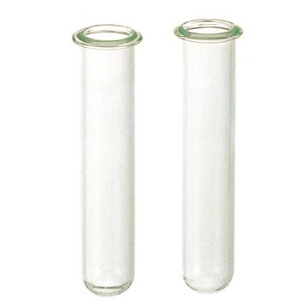
Test Tube
A hollow cylinder of thin glass with one closed end.

Slide 20
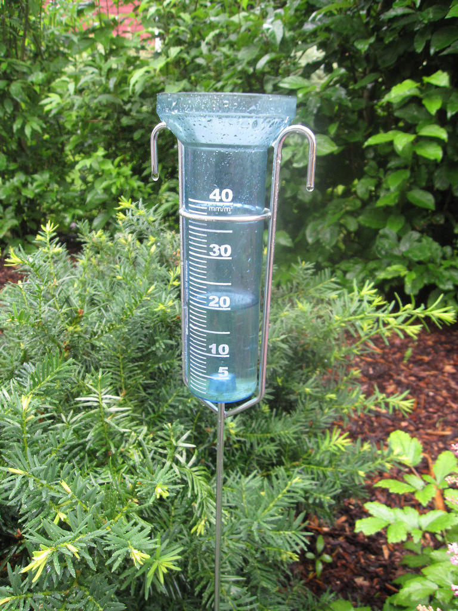
Rain Gauge
An instrument used for measuring rainfall.

